Slide 1
Traversing new terrain: introducing academic research to high school students
Michelle Guittar
Head of Instruction & Curriculum Support
Northwestern University Libraries
LOEX 2019, Minneapolis MN
Notes:
Intro/welcome/thank you
Title of presentation
Rationale and instructional design (using the ACRL framework) for two scenarios working with high school students - when they have a research assignment and when they don’t.
Submitted paper for proceedings

Slide 2
What do you know about school libraries?
Notes:
School libraries?
Hoping for:
Underfunded
Busy
Limited books/less books
OR vital/necessary student support
Depends on the community. These communities create first-year students.
Unprepared for research
Lost
OR very prepared
Focused on output rather than outcomes

Slide 3
Funding for school libraries
Notes:
Let’s talk about funding for school libraries.
In the communities that surround many colleges and universities, high school students are increasingly losing access to the school libraries that support their curriculum or personal interests. In addition to losing space, books, or access to either or both, districts are also losing professional or paraprofessional library staff.

Slide 4
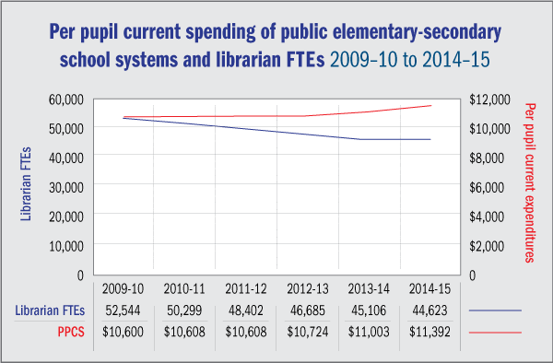
Lance, Keith Curry. 2018. “School Librarian, Where Art Thou?” School Library Journal. March 16, 2018. https://www.slj.com/2018/03/industry-news/school-librarian-art-thou/.
Notes:
As was detailed by a series of online columns entitled “School Librarian: State of the Union” on the website for School Library Journal, school librarians have decreased over the past several years due to changes in school funding priorities, school choice options, and budgets at the national, state, and local level (Jessen 2018, Kachel 2018, Lance 2018).
Between the 1999–2000 and 2015–16 school years, the National Center for Education Statistics (NCES) reports that the profession lost the equivalent of more than 10,000 full-time school librarian positions nationwide. That translates to a 19 percent drop in the workforce, from 53,659 to 43,367. The most rapid declines happened from 2009–10 to 2013–14. The decline slowed from then to 2014–15; but resumed larger losses in 2015–16, the latest data available.

Slide 5
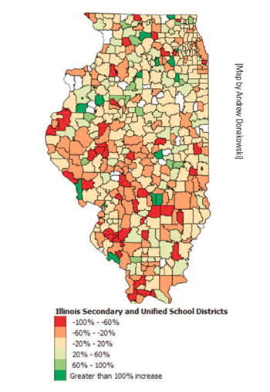
2009 -2014
Guittar, Michelle, and Kelly Grossmann. 2017. “Data Back Up the Headlines: Adding Weight to Advocacy.” ILA Reporter, April 2017.
Notes:
In Illinois specifically, due to its coverage in the local news, Chicago Public Schools (CPS) may be the district that most immediately comes to mind when referencing eliminated librarian positions or supplies budgets, but school districts downstate have felt the most dramatic cuts to their budget allocations for Educational Media Services (EMS).
the ILA Reporter published research that analyzed budgets for educational media services for all secondary districts in the state, and found that on average, those budgets dropped 5%, with greater losses on average in rural school districts (Guittar and Grossmann 2017). This maps the amounts of gains and losses to EMS budgets over the four-year time period of our investigation. On the map, the red and orange districts are those that lost percentages of their budgets from 2009 to 2014, while the light and dark green indicate districts that gained percentages of their budgets from 2009 to 2014. The beige districts have remained relatively neutral, at gains/losses of +/- 20 percent.
The map demonstrates that the districts south of Interstate 80 have generally seen more severe cuts to their budgets for EMS than those districts on the north side of the state. High schools throughout the country are facing these reductions, and that means many of our new first-year students have lived through those reductions.
These reductions present two challenges. First, that many first-year students will arrive at college without familiarity of or skill using basic sources of information like reference books, print journals or periodicals, or academic books, and lacking internet evaluation skills. Second, that even as school libraries are experiencing budget cuts (or ceasing to exist), secondary school curricula can still challenge students to pursue in-depth, independent, and/or college-level research that requires resources beyond what school libraries can offer. Both challenges can co-exist within the same group of students: they may be required to do an in-depth research assignment, but due to lack of access to academic sources of any level, they have to rely on internet “research” to find answers to their questions. Recognizing these challenges, teachers look elsewhere in their community for a place where students can become familiar with academic sources and make progress on their research assignments, and find an academic library.

Slide 6
Not exactly “new terrain”...
Notes:
So having established that school library funding has changed over the years, both in terms of staffing and resources, I should admit this is not a new subject in the professional literature.
Since the 1980s, there has been plenty written on the ways academic librarians have worked with high school students. Authors detail how information literacy standards can bridge the divide between primary and secondary education and higher education. There also exist many formal programs and relationships put into place between high schools and colleges, many of which also have a recruitment component.
Since the ACRL adoption of the Framework for Information Literacy in Higher Education in 2016, there has been very little published on how the Framework can be incorporated into library instructional design in ways that ask younger students to think critically and question information sources. In this paper, I will discuss how I used the ACRL Framework for Information Literacy in Higher Education as the basis for library instruction to two groups of high school students with very different goals.

Slide 7
They have something to do!
Notes:
Scenario 1: students have a goal that supports some curricular need
Research paper/project
AP courses
IB extended essay
History Day projects
AP Research

Slide 8
What is AP Research?
Notes:
AP Research is part of the AP Capstone diploma program from the College Board, and is the second of two year-long AP courses in which students enroll. Students take AP Seminar in the first year, typically when students are in tenth or eleventh grade, and the following year students can take AP Research. AP Research requires students to complete an academic paper of 4,000-5,000 words and a presentation with an oral defense on a “college-level research topic” of personal interest. TAUGHT ALL OVER THE US
A limited but growing number of colleges and universities have publicly endorsed the AP Capstone Diploma program and/or grant credit for a qualifying score, although Northwestern University is not among those institutions that recognize the program (College Board, n.d.).

Slide 9
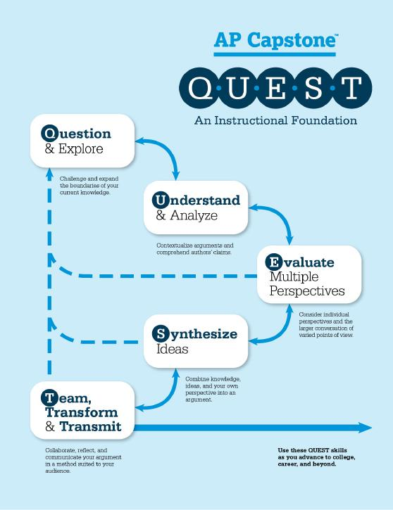
“AP Capstone: How It Works | AP Central – The College Board.” 2018. AP Central. June 4, 2018. https://apcentral.collegeboard.org/courses/ap-capstone/how-ap-capstone-works
Notes:
Learning goals for AP Capstone sequence
Question/explore
Understand/analyze
Evaluate multiple perspectives
Synthesize ideas
Team/transform/transfit

Slide 10
AP Research learning goals | Students will be able to:
Define the broadest possible discipline for their topics and identify relevant keywords for searching. (Searching as Strategic Exploration)
Use NUSearch find a variety of materials, including reference sources. (Research as Inquiry)
Identify and use subject-specific databases to find peer-reviewed articles on their topics for their literature reviews. (Scholarship as a Conversation)
Notes:
In 2017/2018, a Title I school in the Chicago suburbs asked if they could bring their AP Research students to the Northwestern Library for a “research day.” According to the teachers of the class, the students had access to a school library that offered databases and resources appropriate for high school curricula, but did not have access to peer-reviewed journal literature that the students needed for their research. They arrived by bus, and planned to be at the library for 3 hours. The discussion below will focus on the November 2018 visit that included 18 students and 2 teachers.
In this case, the students arrived at the library with clearly defined research questions and some preliminary research already completed, I designed our instruction to focus on the frames Research as Inquiry, Scholarship is a Conversation, and Searching as Strategic Exploration. We made the visit as interactive as possible and took frequent workshop breaks to let the students practice using various tools soon after we introduced them.
Room context - fit in computer classroom w/ 24 workstations, white boards

Slide 11
AP Research assessment/activities
Which keywords were most effective in your database searches? | Model the move from a research question to keywords with an example. Crowd-source a list of synonyms for the topics/themes/nouns in the research question.
Write the name of a reference source you identified using NUSearch. | Brief introduction to finding reference sources, ask students to find a reference source. Discuss the characteristics of reference sources.
Write the citation for a source that you will use in your research. | Compare topic results of NUSearch to that of a subject-specific database. Explore multiple databases to determine which one has the most relevant scholarship.
Notes:
Hoped they could do at end of the session / How we go there
Assessment was discussion/workshop time and brief short answer quiz at the end of the time

Slide 12
Questions/keywords (with disciplines)
To what degree does student perception of task difficulty impact their performance? | performance, task difficulty, task complexity, students (Education)
To what extent has the Marvel Cinematic Universe broken away from traditional racial stereotypes in their characters from 2000-present? | marvel films, diversity, stereotypes, race (Film Studies)
How does rap music influence the perceived behavior and actual behavior of high school students? | rap, behavior, teens, high school (Psychology and Music)
Notes:
The results of the formative assessment were overall positive: Nearly all students who completed the quiz were able to pull out at least three relevant keywords or key phrases to use in their research. The students were able to identify the broad disciplines of their research, with the majority of students interested in topics in psychology, education, environmental studies, or social services.
No students had problems finding a citation for a useful source, although many struggled still when asked to identify a reference source! Would have thought basic understanding/familiarity after introduction to reference sources. In future visits, we will plan to spend more time on how the reference sources can help students navigate the larger research surrounding their topics. (And spend more time with this with first-year students).

Slide 13
“My students really love this field trip, it wouldn't be nearly as enjoyable or even possible without all your help and support. We really appreciate you allowing us to do this; and YES!! We will definitely be back next year!”
Notes:
To assess the teachers’ satisfaction with the visit, I followed up via email with the co-teachers who brought their AP Research students to the library. I got the following note back from one of the teachers: “My students really love this field trip, it wouldn't be nearly as enjoyable or even possible without all your help and support. We really appreciate you allowing us to do this; and YES!! We will definitely be back next year!”
For this class in particular, we found that the AP Research curriculum had well-prepared the students to succeed when they visited the Northwestern University Library, and the short amount of time the students had planned to be in an academic library made them very focused researchers. This lesson plan can serve as paradigmatic for working with high school students who come to the library with clearly defined research questions and previous experience researching either online or through their school library.

Slide 14
What if they don’t have something to do?
Notes:
Okay, the second scenario!
As academic librarians, we dread this! But same principles apply here. Know your audience and their goals for the visit.
Unlike AP Research, in which students arrived at the library with a clearly defined independent research project, the library also hosts groups of students who come for a visit without a specific research agenda in mind. Student visits from Schuler Scholar Program provide one example.

Slide 15
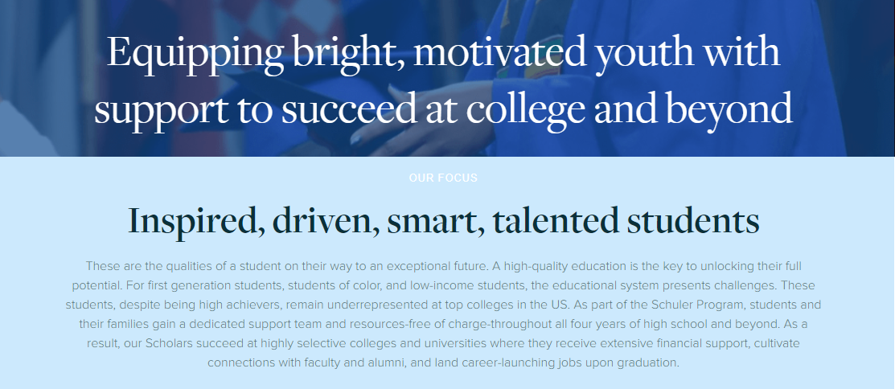
What is the Schuler Scholar Program?
Notes:
Based in the Chicago metropolitan area, the Schuler Program recruits high-achieving freshmen high school students that are first-generation, students of color, and/or low-income students and offers dedicated support and resources throughout their four years of high school and beyond (Schuler Scholar Program 2019).
Goal is to help Scholars become success not just throughout high school, but in college and beyond, so programming works to build skills, confidence, and strong academic identities. Talk about coaching model, after school program, tutoring, test prep
As part of their experience, the Schuler Program also offers cultural experiences, called “exposures,” to students, to help them integrate into the high-achieving liberal arts colleges that they encourage students to attend (Schuler Cultural Exposures 2019).
In fall 2018, through a personal connection, I met Zoe Chachamovits, Program Associate with the Schuler Scholar Program. She was interested in taking her students on an exposure to an academic library, but the students did not have a research assignment they had to complete. They had
(Z) Some exposure of scholars to research, but variety of exposure to libraries at their high school
Initially, our plan was to keep it more general--get some initial exposure to the library, have a mini lesson, and then do some sort of mini research project. Then, I started thinking more about what would be exciting to students, and most of our Scholars are socially aware and interested in current events, so this felt like it would be more compelling in addition to those original goals.
Rather than focusing on building students’ research skills in databases that they would not have access to for years, we instead decided to focus on analyzing news sources for bias and comparing them to academic sources. I met with three groups of Schuler Scholars this academic year, all from different high schools, and below I will cover what I did when I met with a group of Scholars in March 2019.

Slide 16
Schuler Scholar learning goals | Students will be able to:
Identify bias in sources. (Authority is Constructed and Contextual)
Name differences between media and academic sources. (Information Creation as a Process)
View the research process as iterative, and themselves as actors within it. (Research as Inquiry)
Notes:
In designing the two-hour session, I started with the ACRL Framework frames of Authority is Constructed and Contextual, and Information Creation as a Process. The learning goals are detailed on the table below. In this case, the ongoing discussion between the Scholars was the primary method of formative assessment in the session. I acted as discussion guide, and recorded our discussions on whiteboards in the room. As a secondary assessment, I also asked the Scholars to draw how they see the research process at the outset and at the end of class, reflecting on how those views changed after our discussions.
Topic: MIGRANT CARAVAN
Room context: I met with the group in an active learning classroom without any computers, and this lesson plan included no database demos, cataloging searching, or computer use. I provided all the images and sources through handouts and a Google Slides presentation. The discussion engaged the students almost the entire time. In their pre- and post- drawings, I noticed that the students frequently started with a linear process that moved from topic to research to handing in their paper. In one notable example from 2018, the drawing of one student changed to start with questioning current events, asking questions, seeking multiple perspectives, and then being able to talk about the topic.

Slide 17
Identify bias (Authority), Name differences (Process)
Compare two images of migrants at a border: A group of men vs. a family surrounded by Border Patrol.
Compare the use of those images in two news publications.
Compare a webpage from the Department of Homeland Security vs. an opinion column from the El Paso Times.
Notes:
Who wrote this? Why?
What questions do you have after looking at this source?

Slide 18
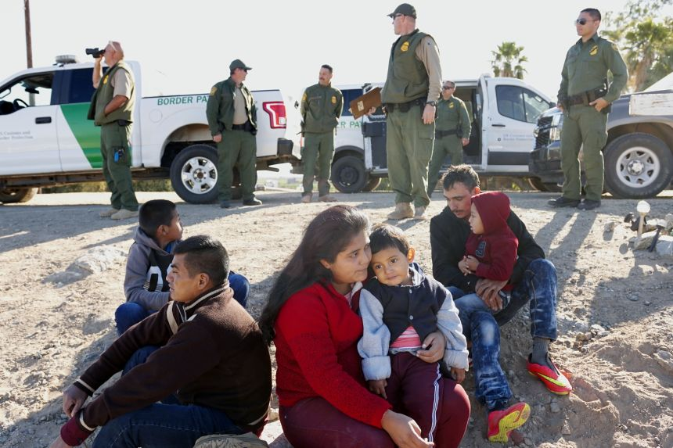
Notes:
Talk about it
Compare images of migrants @ border

Slide 19
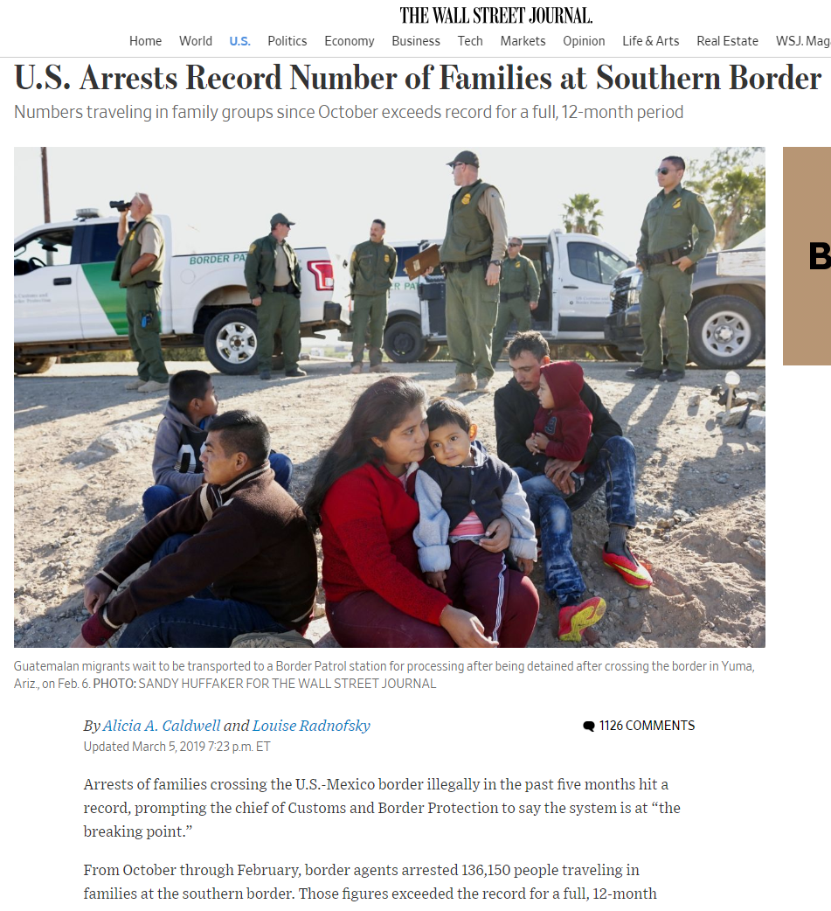

Slide 20
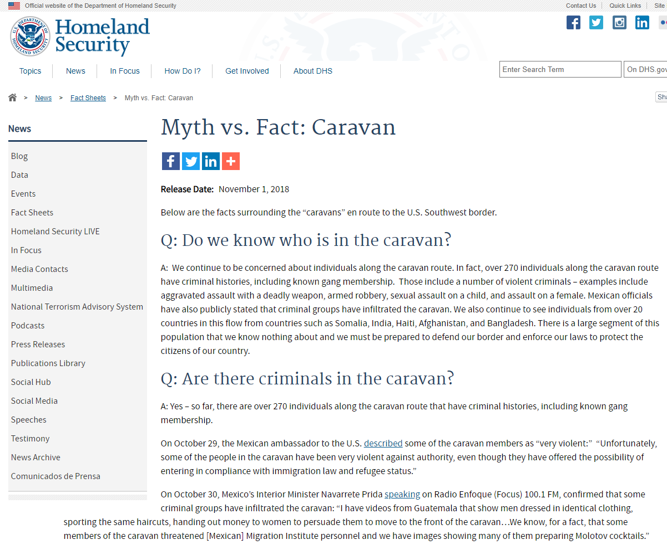
Notes:
https://www.dhs.gov/news/2018/11/01/myth-vs-fact-caravan
https://www.elpasotimes.com/story/opinion/2019/02/15/violent-crime-el-paso-before-and-after-border-fence-column/2875181002/

Slide 21
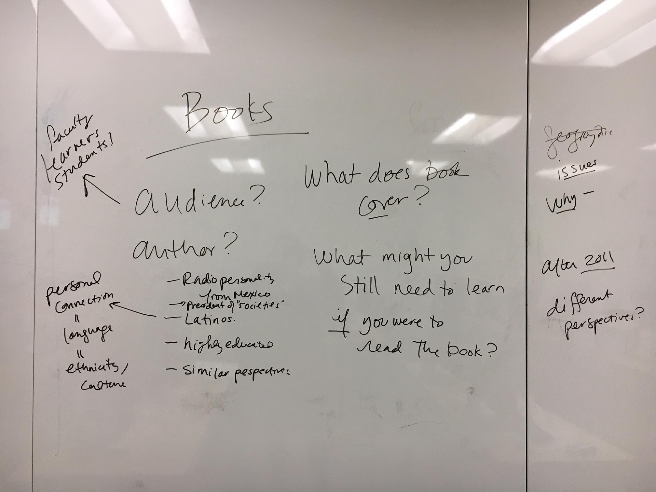
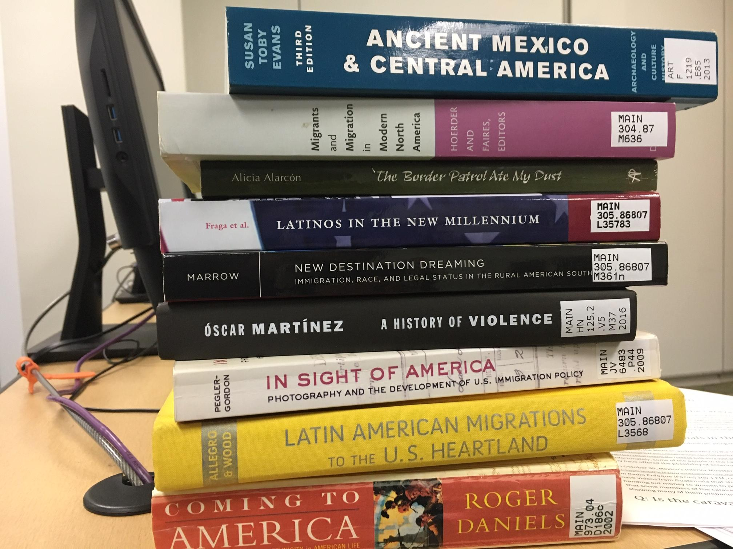
Notes:
Given call number range
Retrieval
Same exercise w/ academic books
Audience
Author
Content of books
Limits of books

Slide 22
Zayas, Luis, and Lauren Gulbas. “Processes of Belonging for Citizen-Children of Undocumented Mexican Immigrants.” Journal of Child and Family Studies, vol. 26, no. 9, 2017, pp. 2463–2474. https://doi.org/10.1007/s10826-017-0755-z
Notes:
Parts of the citation
Who would read this? (ask)
What is this article not about?
All undocumented peoples, parents and kids
Other groups than citizen children with Mexican parents
Not about their economic status, or geography
Just about the underlined themes - sense of belonging, psychological effects
THEN we did a JSTOR introduction, only after establishing that students could read the citation and discussing an abstract

Slide 23
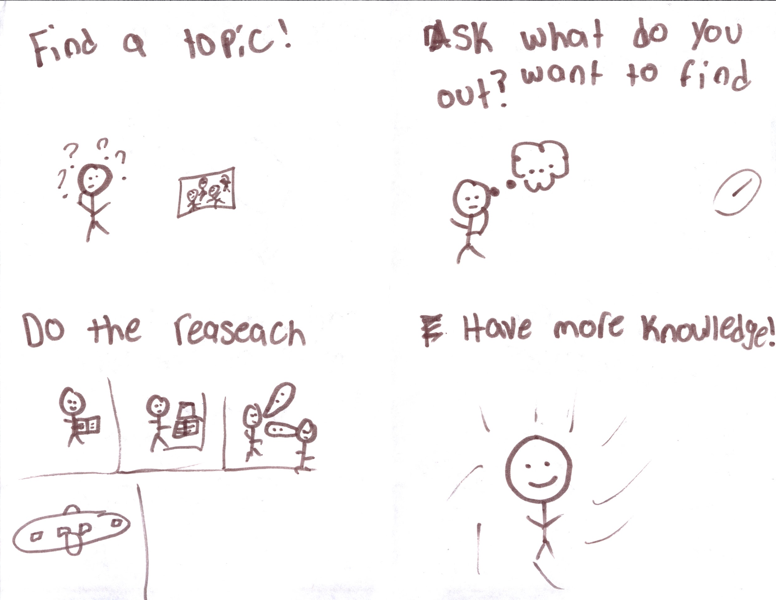
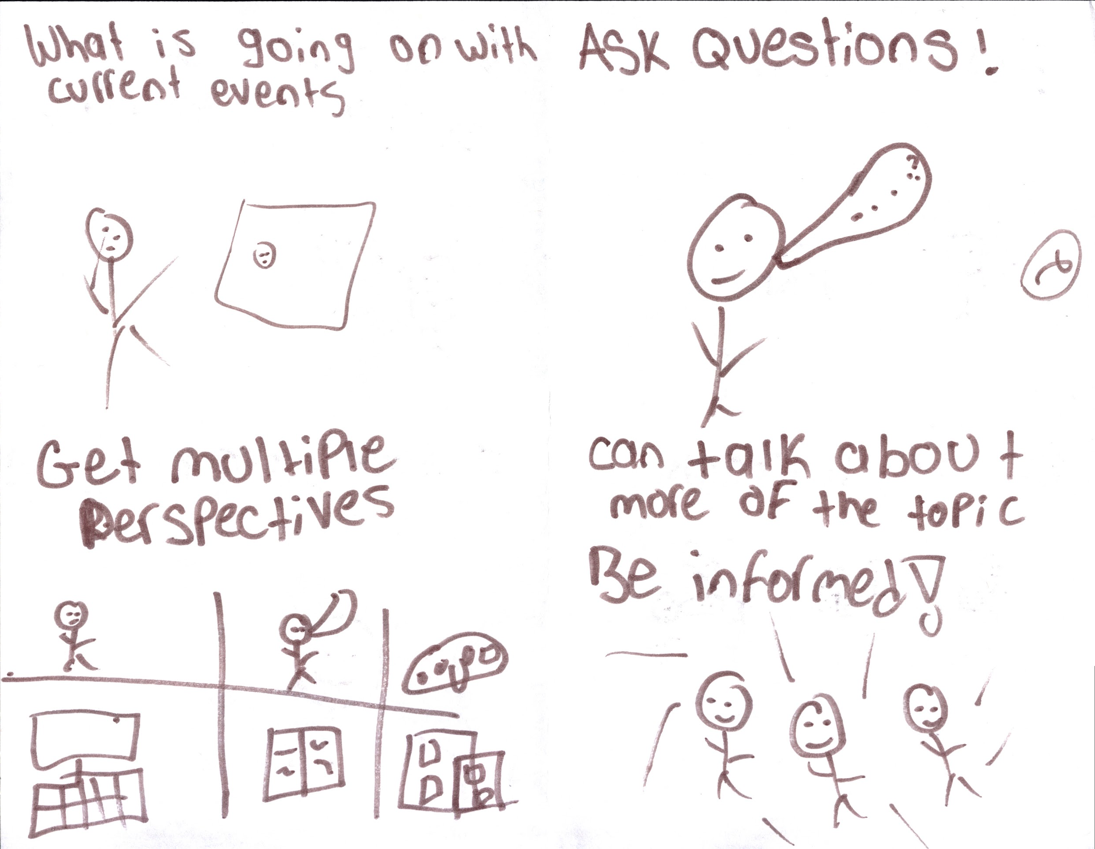
As actors in an iterative research process...
Notes:
Beginning/end of class drawings (explain)
Although the shift is subtle, this example demonstrates that instead of serving as a passive consumer of information, the student instead sees him/herself as an actor who can interrogate sources and actually be able to send that knowledge back out into the world with their own voice. Throughout the lesson, the students became comfortable with identifying the authors, audience, and purposes of the different sources that we looked at, and as we progressed to more academic sources, students were able to quickly contextualize its information as for scholars and practitioners in the field rather than a general audience

Slide 24
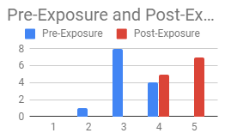
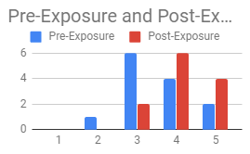
I feel confident in my ability to find and utilize non-internet sources (i.e. books) (scale of 1-5)
I feel confident in my ability to think critically about the information I receive before believing it (scale of 1-5)
Chachamovits, Zoe, and Michelle Guittar. 2019. “‘What’s Really Going On Here?’ Engaging and Contextualizing the Media Landscape with High School Students.” presented at the Information Literacy Summit, Moraine Valley Community College, April 5. https://docs.google.com/presentation/d/1NrSPe-CJKByMzIaijoazJualemLq1OpM2VJggIRLVFQ.
Notes:
Larger Schuler goals of confidence/comfort/emotions.
In confidence surveys conducted by Zoe Chachamovits before and after the visit, the Scholars self-identified as being much more confident in their ability to think critically about the information they receive after their exposure at Northwestern (Chachamovits 2019). In the coming year, up to twenty groups of Schuler Scholars could come to Northwestern University Libraries for a similar exposure.

Slide 25
Why do it?
Notes:
Welcoming groups or classes of high school students to academic libraries addresses both the challenges that decreased funding for school libraries can present. Academic librarians can help high school students gain familiarity with and skill using basic information sources, and we can introduce those students that need it to the kinds of sources they need to do in-depth, college-level research projects.
While working with high school groups is far from new terrain for academic librarians, mapping these visits to the ACRL Framework for Information Literacy in Higher Education still is. Relying on the instructional design cycle of setting learning goals and designing assessments and activities allows us to construct engaging, student-centered learning experiences that will resonate with high school students much longer than an orientation to the space or database demonstration.
Whether the students visit the library to learn to analyze bias and distinguish sources or to conduct in-depth research, centering critical thinking and inquiry as the central goal of the session will serve to better prepare students for college, while continuing to promote the academic library as a welcome place, regardless of whether students attend your specific institution.

Slide 26
Questions?
Thank you!
Michelle Guittar
Head of Instruction & Curriculum Support
Northwestern University Libraries
@guittarma

